Slide 1
Personas and user stories
Hannu Markkanen, Amir Dirin

Slide 2
Who are the users, why and how they would use your application?
Persona - fictive or research based description of a typical user.
User story - what the user would like to accomplish, why and how does one know the application did what the user wanted to do

Slide 3
Personas and user stories as tools for requirement capture
Idea -> identify user groups -> personas -> user stories -> product backlog
persona
Application idea
Product backlog
persona
persona

Slide 4
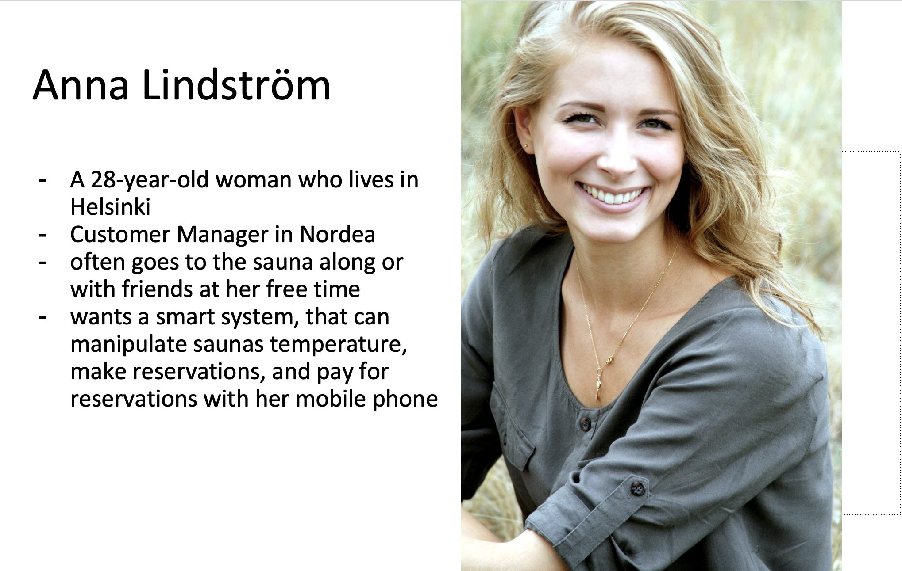
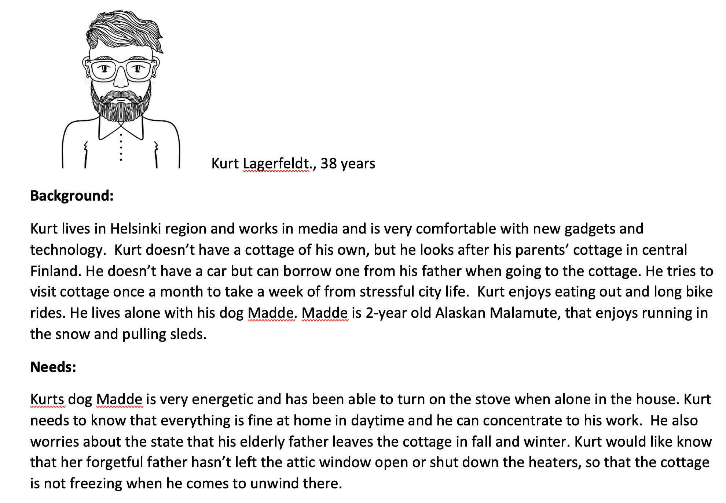
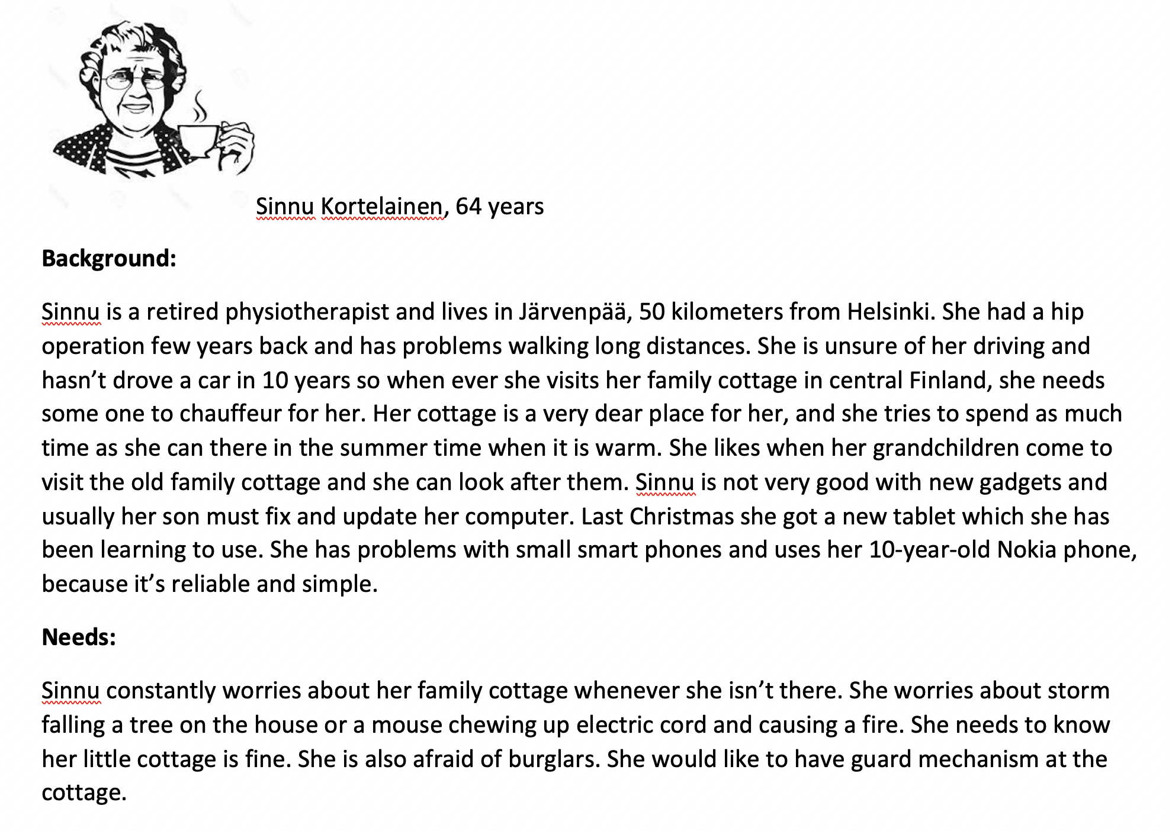
Sample personas

Slide 5
User story captures a requirement: Who, What, Why
a concise description of a piece of functionality that will be valuable to a user or owner of the software
As a [type of the user] I want [to do something] so that [I can achieve a goal]
Should be written in language that the user understands.

Slide 6
User stories can be used as a basis for app development
Who - description of the user
What - describes the functionality user wants => design & implementation
Why - what the user wants to achieve => test acceptance criteria
Conditions - description of state before the use story actions => pre-conditions for a test case
Acceptance criteria - define when the implementation is done => test acceptance criteria

Slide 7
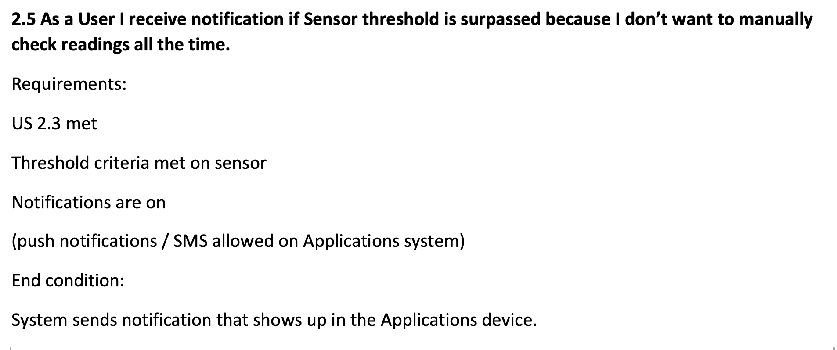
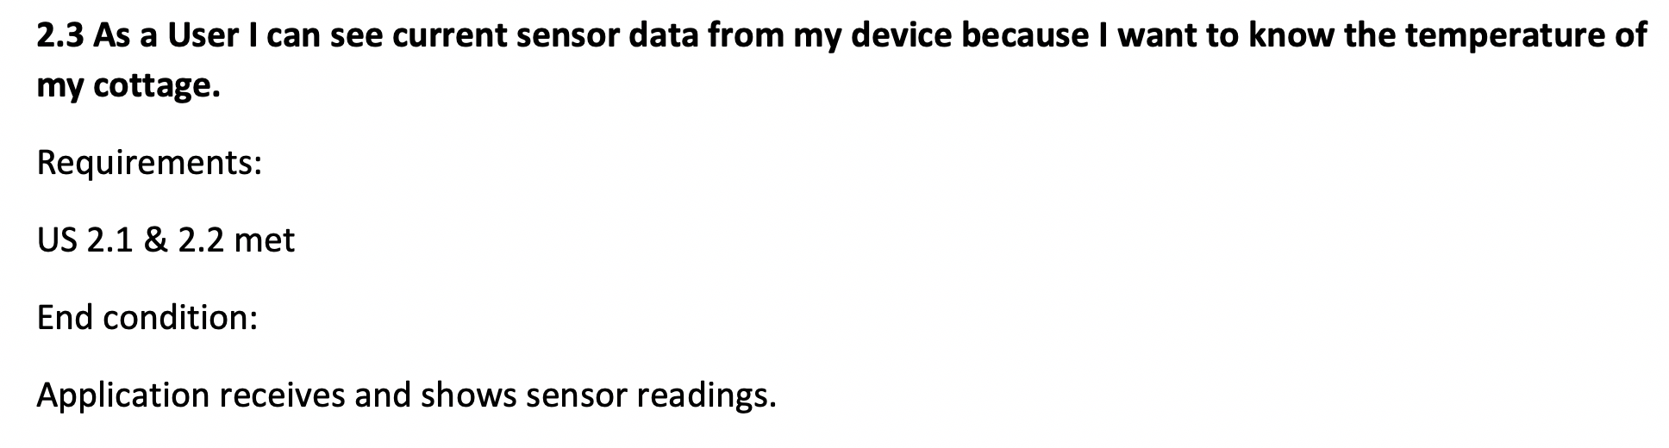
Sample user stories

Slide 8
Personas and user stories as tools for requirement capture
Idea -> identify user groups -> personas -> user stories -> product backlog
persona
Application idea
Product backlog
persona
persona

